Slide 1
Analyzing Health Equity Using Household Survey Data
Lecture 4
Health Outcome #2: Anthropometrics
Notes:
Malnutrition remains a widespread problem in developing countries, in particular among the poorest and most vulnerable segments of the population.
Typically, malnutrition is caused by a combination of inadequate food intake and infection that impairs the body’s ability to absorb or assimilate food. It is an important cause of low birth weight, brain damage, and other birth defects and contributes to developmental (physical and cognitive) retardation, increased risk of infection and death, and other problems in infants and children.
Reducing by half the proportion of children that suffer from hunger is Target 2 of MDG 1. The second indicator of this target is defined in terms of the proportion of underweight children less than five years old (i.e. weight-for-age z-score less than -2 – see below).
Anthropometric indicators are used to assess nutritional status. They are derived from physical body measurements, such as height or weight (in relation to age and sex).
Anthropometric indicators can be used to monitor population nutritional status and have been used used to measure differences in health between the rich and poor for a very large number of low-income countries using the Demographic and Health Surveys (Gwatkin et al, 2000 and 2007).
This presentation covers the construction, interpretation and use of anthropometric indicators, with a concentration on those used for infants and children. We begin with an overview of the indicators, continue with their computation and end with their analysis.

Slide 2
Anthropometric indicators
Identify “abnormal” departures of height/weight from median at given age/sex in a well-nourished population.
Weight-for-height
Height-for-age
Weight-for-age
Notes:
Weight and height do not indicate malnutrition directly. Besides age and sex, they are affected by many intervening factors other than nutrient intake, in particular genetic variation. However, even in the presence of such natural variation, it is possible to use physical measurements to assess the adequacy of diet and growth, in particular in infants and children. This is done by comparing indicators with the distribution of the same indicator for a “healthy” reference group and identifying “extreme” or “abnormal” departures from this distribution.
The three most commonly used indicators for children and infants are …..
The three indicators differ in the extent to which they measure short-term or chronic malnutrition.

Slide 3
Weight-for-height (W/H)
Indicator of current nutritional status
Used for screening kids at risk & to identify short-term changes in nutritional status
Low W/H = “thinness”, extreme =“wasting”
Wasting can be due to starvation or severe disease (especially diarrhea)
At other extreme, identifies obesity
Notes:
1. More precise definition of thinness and wasting are given below.

Slide 4
Height-for-age (H/A)
Reflect cumulative linear growth
H/A deficits indicate past inadequate nutrition and/or chronic/frequent illness
Not measure of short-term changes
Low H/A =“shortness”, extreme=“stunting”
Mainly used as population indicator, not for individual monitoring
Notes:
1. Again, precise definition of stunting is given below.

Slide 5
Weight-for-age (W/A)
Composite measure of H/A and W/H
So, interpretation difficult. Confounds short- and long-term problems
Low W/A=“lightness” extreme=“underweight”
Used for monitoring growth and change in malnutrition over time
Indicator used for MDG1(Target 2)
Notes:
1. Millennium Development Goal 1, Target 2 is expressed in terms of the proportion of underweight children.

Slide 6
Reference population
Until 2006, WHO recommended use of US NCHS reference group (US sample)
Distribution of child height/weight mostly determined by nutrition & disease, not ethnicity
But controversy over the use of the US reference
In 2006 WHO issued new growth standards for 0-5 years based on the Multi-Centre Growth Reference Study
New standards calculated from samples from diverse ethnicity all adopting recommended practices e.g., breastfeeding, no smoking
Notes:
All indicators involve comparison the of the measure with that in a well-nourished population
Evidence in support of the second observation used to justify the use of the US reference population.
Beyond a certain age, height is more determined by genetic factors and so cross-country comparisons of adult height is more problematic. But in childhood, net nutritional intake is the dominant determinant.
The new standards adopt a fundamentally prescriptive approach designed to describe how all children should grow rather than merely describing how children grew in a single reference population at a specified time (Garza & de Onis, 2004).
Population stunting rates based on the new MGRS reference tend to be higher than those based on the NCHS sample (de Onis et al, 2006; Van de Poel et al, 2007). Most probabaly this is because the new growth standards attempt to identify growth potential following recommended health behavior rather than simply taking the observed distribution in a random US sample.
Garza, C., & de Onis, M. (for the WHO Multicentre Growth Reference Study Group). (2004). Rationale for developing a new international growth reference. Food and Nutrition Bulletin, 25 (Suppl. 1), S5–14.
de Onis, M., Onyango, A., Borghi, E., Garza, C., & Yang, H. (for the WHO Multicentre Growth Reference Study Group). (2006). Comparison of the World Health Organization child growth standards and the National Center for Health Statistics/WHO international growth reference: implications for child health programmes. Public Health Nutrition, 9(7), 942-947.
E.Van de Poel, O. O’Donnell and E. Van Doorslaer, Are urban children really healthier? Evidence from 47 developing countries, Social Science and Medicine, 2007, 65 (10): 1986-2003,

Slide 7
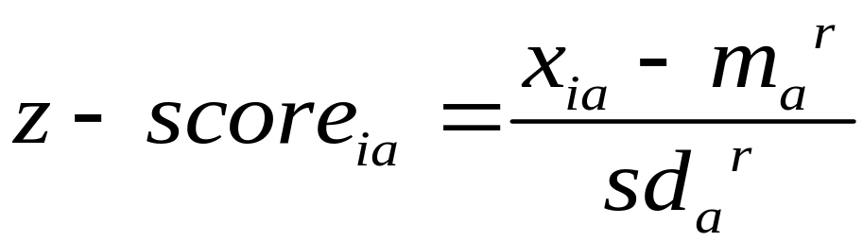
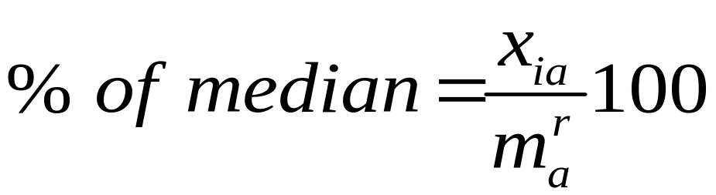
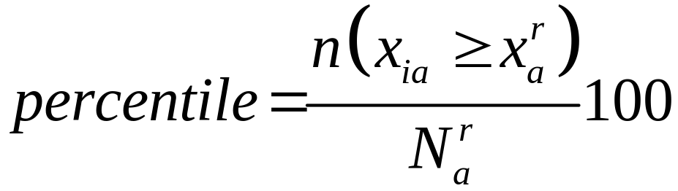
Comparison with the reference population
Notes:
i is the index for the individual and a for her age/sex group. X_{ia} is weight/height, height or weight of the individual in age/sex group a. m_{a}^{r} is the median of the same variable for individuals in the same age/sex group in the reference population. sd_{a}^{r} is the standard deviation for the age/sex group in the reference population.
n(x_{ia}>x_{a}^{r}) is the number of observations in the respective age/sex of the reference sample that have height/weight less than the individual and N_{a}^{r} is the total number in that age/sex group in the reference sample.
The preferred and most common way of expressing anthropometric indices is in the form of z-scores. That approach has a number of advantages. Most important, z-scores can be used to estimate summary statistics (e.g., mean and standard deviation) for the population or subpopulations. This cannot be meaningfully done with percentiles. Moreover, at the extreme of the distribution, large changes in height or weight are not necessarily reflected in changes in percentile values. The percent of median is deficient relative to the z-score in that it expresses deviation from the reference median without standardizing for the variability in the reference population.

Slide 8
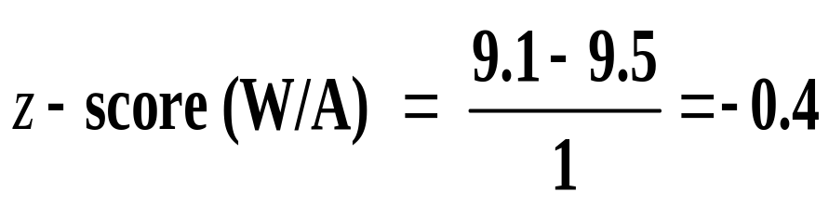
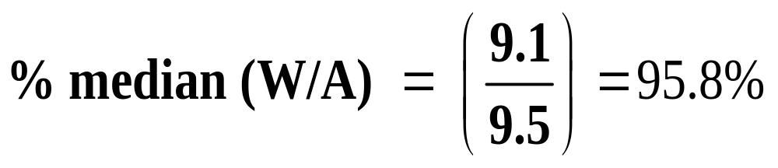
Example Computation of Anthropometric Indices
12-month-old girl weighs 9.1 kg
In reference sample, median weight for 12-month-old girls is 9.5 and standard deviation is 1.0.
9.1 falls between the 30th and 40th percentile in
reference distribution

Slide 9
Criterion for malnutrition
z-score less than -2 is most common criterion
That is, 2 standard deviations below the median in reference population
In reference population, approx. 2.3% of children have abnormal deficit by this criterion
W/H z-score < -2 = “wasting”
H/A z-score < -2 = “stunted”
W/A z-score < -2 = “underweight”

Slide 10
WHO Classification Scheme for Degree of Population Malnutrition
Degree of malnutrition | Prevalence of malnutrition (% of children <60 months, below –2 z-scores)
 | W/A and H/A | W/H
Low | <10 | <5
Medium | 10–19 | 5–9
High | 20–29 | 10–14
Very high | >=30 | >=15
Source: WHO 1995.
Notes:
These are the rates of malnutrition that WHO has proposed correspond to different degrees of malnutrition in the population.
WHO has also proposed a more general malnutrition classification that distinguishes between mild (z-score ≤1), moderate (z-score ≤2), and severe malnutrition (z-score ≤3).

Slide 11
WHO recommended exclusion ranges for “implausible” z-scores
Indicator | Exclusion range for z-scores
Height-for-age | <5.0 and >+3.0
Weight-for-height | <4.0 and >+5.0
Weight-for-age | <5.0 and >+5.0
Note: If observed mean z-score is below –1.5, the WHO recommends that a flexible exclusion range be used. For details, see WHO (1995).
Notes:
1. Measurement errors may arise in measurement of weigth/height, recording of age or in coding. This may lead to biologically implausible values for z-scores. WHO recommends that values outside the above ranges being treated as corresponding to missing data.

Slide 12
Body Mass Index
Weight in kilos divided by the square of height in meters
Used to define thinness & overweight in adults
BMI Cutoffs for Adults over 20 (proposed by WHO expert committee)
BMI range | Diagnosis
<16 | Underweight (grade 3 thinness)
16–16.99 | Underweight (grade 2 thinness)
17–18.49 | Underweight (grade 1 thinness)
18.5–24.99 | Normal range
25.0–29.99 | Overweight (preobese)
>30 | Obese
Notes:
1. Obesity is a recognized problem in high-income countries and a growing one in many developing countries, including, for example, China.

Slide 13
Computation of anthropometric indicators
ANTHRO uses 2006 WHO growth standards
EPI-INFO uses various reference populations
Stata ado files:
  zanthro
  igrowup (calls ANTHRO)
Notes:
ANTHRO program files and supporting documentation can be downloaded from http://www.who.int/childgrowth/software/en/ and anthro2005@who.int .
EPI-INFO programs, documentation, and teaching materials can be downloaded from http://www.cdc.gov/epiinfo/index.htm . EPI-INFO is a CDC trademark, but may be freely copied, distributed, or translated.
zanthro is an ado-file developed by Suzanna Vidmar and Tim Cole. It can be installed in Stata be typing webseek zanthro and following the instructions.
4. igrowup ado files from the same source as ANTHRO

Slide 14
Using zanthro
egen haz = zanthro(height_cm, ha, US), xvar(age_months) gender(sexo) gencode(male=1, female=2) ageunit(month)
egen whz = zanthro(weight_kilos, wh, US), xvar(height_cm) gender(sexo) gencode(male=1, female=2)
egen waz = zanthro(weight_kilos, wa, US), xvar(age_months) gender(sexo) gencode(male=1, female=2) ageunit(month)
Notes:
Note, have broken lines here. Would need to comment out the line break or change line break to ; etc.
The first variable in parentheses is the raw measure – height/weight. The second defines whether heigth-for-age (ha), wight-for-height (wh) or weight-for-age (wa) is to be calculated. The third selects the reference standard population, here the US. xvar identifies the age variable (or height in the case of whz). gender and gencode identify the gender variable and its coding. ageunit identifies how age is measured.

Slide 15
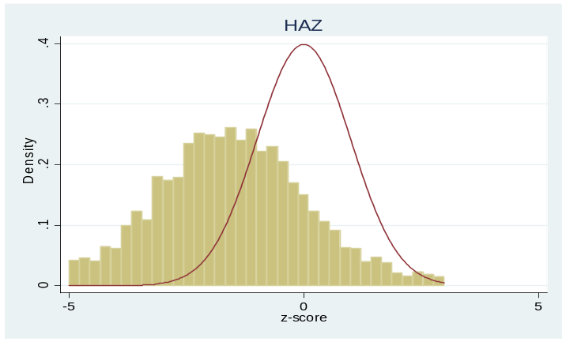
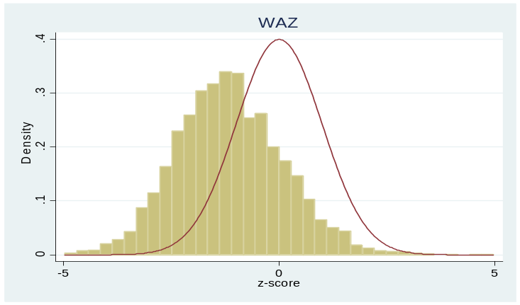
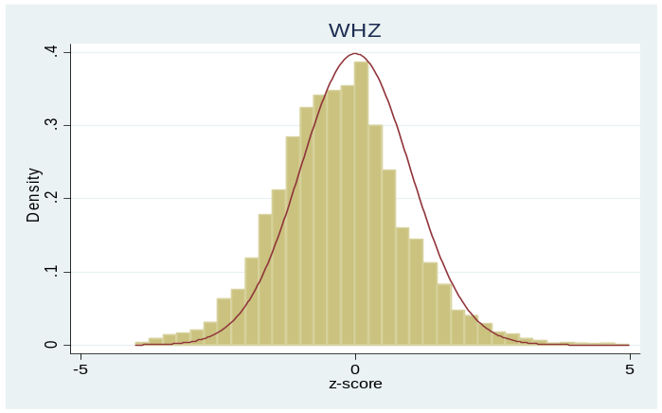
Distribution of z-Scores in Mozambique, 1996/7
 | HAZ | WAZ | WHZ
Mean | –1.88 | –1.28 | –0.15
Standard deviation | 1.74 | 1.31 | 1.34
% below –2 S.D | 46.1 | 28.8 | 6.4
% below –3 S.D. | 25.4 | 8.4 | 1.1
Notes:
The 1996/97 Mozambique National Household Survey on Living Conditions (Inquérito Nacional aos Agregados Familiares Sobre as Condições de Vida) was designed and implemented by the National Statistics Institute in Mozambique and was conducted from February 1996 to April 1997. The sample covers approximately 43,000 individuals in 8,250 households. It was selected in three stages and is geographically stratified to ensure representativeness at the provincial level and for urban/rural areas.
As can be seen from the graphs and the table, there are deficits in both H/A and W/A, but only limited evidence of wasting.

Slide 16
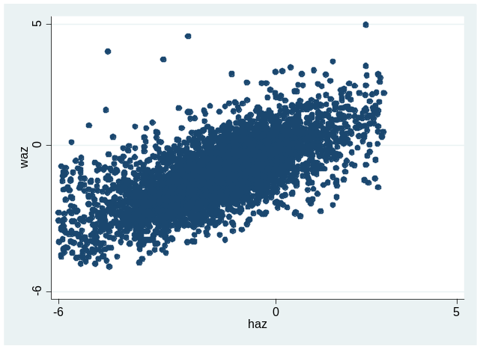
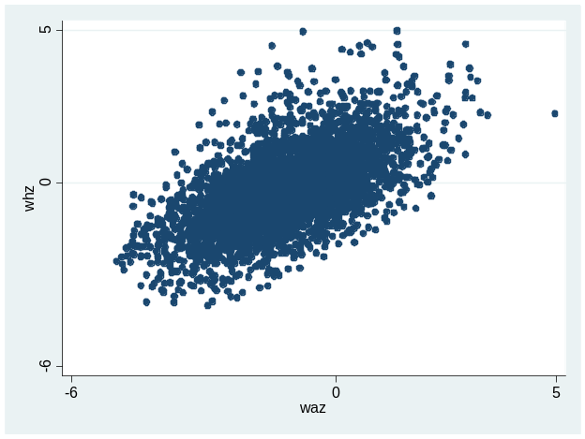
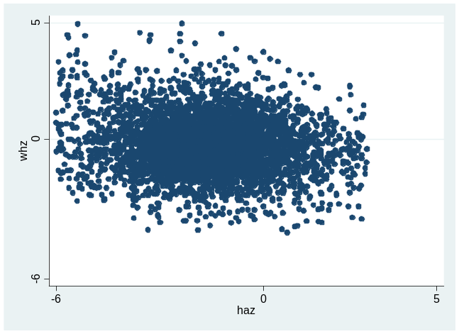
Correlation between Different Anthropometric Indicators in Mozambique
waz-haz
whz-waz
whz=haz
Notes:
1.In general, weight-for-height and height-for-age are not correlated, whereas there tends to be a positive correlation between weight-for-height and weight-for-age and between weight-for-age and height-for-age. This pattern is confirmed in the Mozambique data.

Slide 17
Stunting, Underweight, Wasting by Age and Gender in Mozambique
Age (month) | Group | HAZ< –2 | WAZ< –2 | WHZ< –2 | n
0–23 | Boys | 44.6 | 35.8 | 11.2 | 1,025
 | Girls | 36.0 | 23.5 | 5.7 | 1,072
 | Combined | 40.0 | 29.2 | 8.3 | 2,097
24–60 | Boys | 53.6 | 28.0 | 5.0 | 1,207
 | Girls | 49.3 | 29.2 | 4.4 | 1,210
 | Combined | 51.5 | 28.6 | 4.7 | 2,417
Notes:
For many purposes, anthropometric data should be presented according to age and sex groups. The reason is that
(i) patterns of growth failure vary with age,
(ii) the identification of determinants of malnutrition is facilitated,
and (iii) as a consequence of irregularities in the reference curves, wasting tends to be exaggerated for children in the 12- to 24-month age group.
2. WHO (1995) recommends that at least two age disaggregations be used—under 24 months and 24 months and over—but for some purposes a more detailed disaggregation may be advisable.

Slide 18
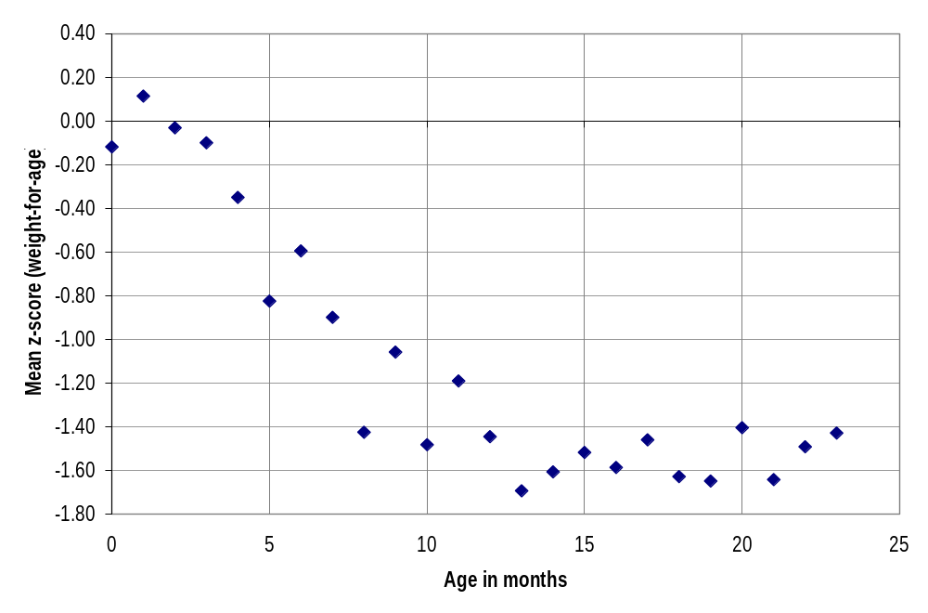
Mean z-Score (weight-for-age) by Age in Months, Mozambique
Notes:
To better understand the nature of malnutrition, it can be useful to look at the mean z-score for smaller age groups (e.g., by month).
z-score weight-for-age in children in Mozambique reaches very low levels already by the age of 10 months.

Slide 19
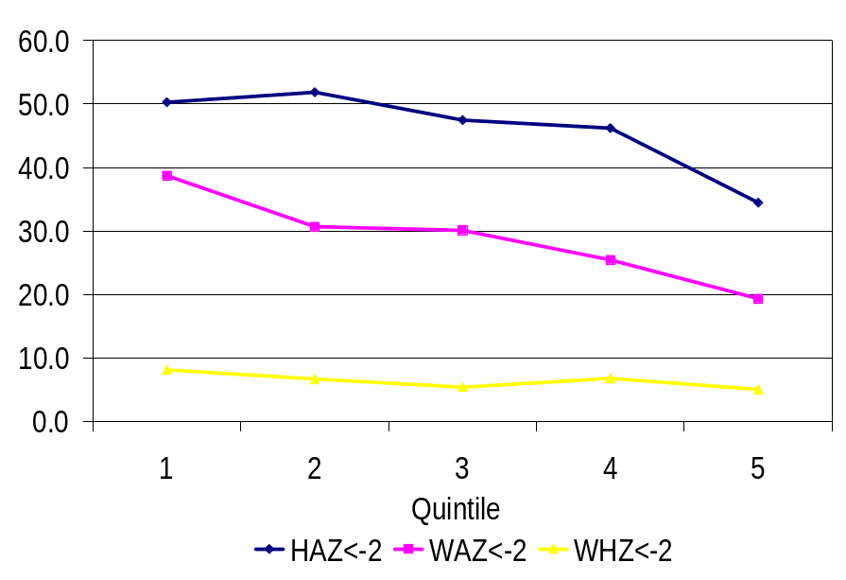
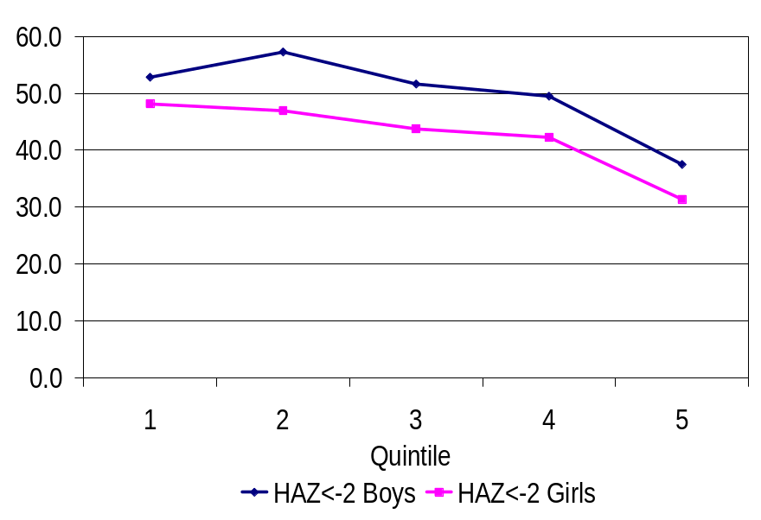
Malnutrition by consumption quintile in Mozambique
Prevalence of stunting, underweight, and wasting by quintile in Mozambique | Prevalence of Stunting by Quintile and Sex in Mozambique
Notes:
1. The graphs show the expected tendency for malnutrition to be worse in poorer quintiles. But analysts should avoid drawing unwarranted conclusions about socioeconomic inequalities. In particular, it is important to look beyond the simple means by quintiles to assess whether the observed differences are significant. For example, in the case of stunting, a more detailed analysis of the Mozambique data reveals that the only statistically significant difference in prevalence between consumption quintiles is between the richest quintile and the rest. Moreover, although comparing means by quintiles is a useful place to start, it is quite a crude approach to assessing socioeconomic inequalities, and analysts should consider using concentration curves and indices discussed in lectures 7 and 8.

